Slide 1
Wi-Fly? Detecting Privacy Invasion Attacks by Consumer Drones
By: Kelli Kinnikin, Ashton Toler, and Nick Fresta

Slide 2
Introduction:
Drone Detection System to detect drones that are carrying out privacy invasion attacks.
Model of the attack structure to derive statistical metrics for movement and proximity, that are then applied to receive communications between a drone and its controller.
Tested their system with two popular consumer drone models mounting privacy invasion attacks using a range of flight patterns.

Slide 3
How to Detect Drones(Part 1):
Through the use of radar.
Drones propose an approach that uses humans as sensors by building a collaborative smartphone app that allows users to share drone sightings.

Slide 4
How to Detect Drones(Part 2):
Another way to detect drones is based on video cameras and image analysis.
Detect small UAVs by using both their appearance and motion cues.
According to the work, the variety of drone shapes is challenging for appearance-based approaches, where as methods based on motion cues struggle with similarities between drone and bird movement.

Slide 5
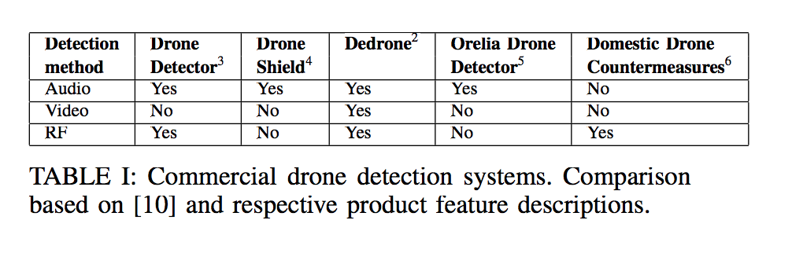
How to Detect Drones(Part 3):
Hybrid approaches such as CSUAV combine radar, acoustic arrays and video cameras to profit from the benefits of all approaches.

Slide 6
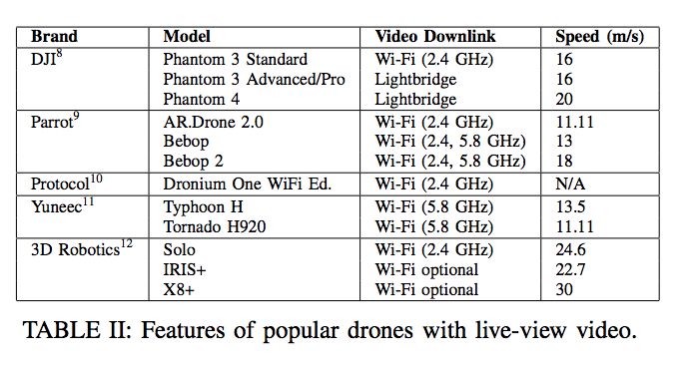
Background:
Drones are taking over the US market.
Provide live FPV (First Person View)
New drones are using “Light Bridge” tech.
Jurisdictions have different rules for drone flying.

Slide 7
Adversary Model:
We identify three phases of the attack:
1.) Approach
2.) Surveillance
3.) Escape

Slide 8
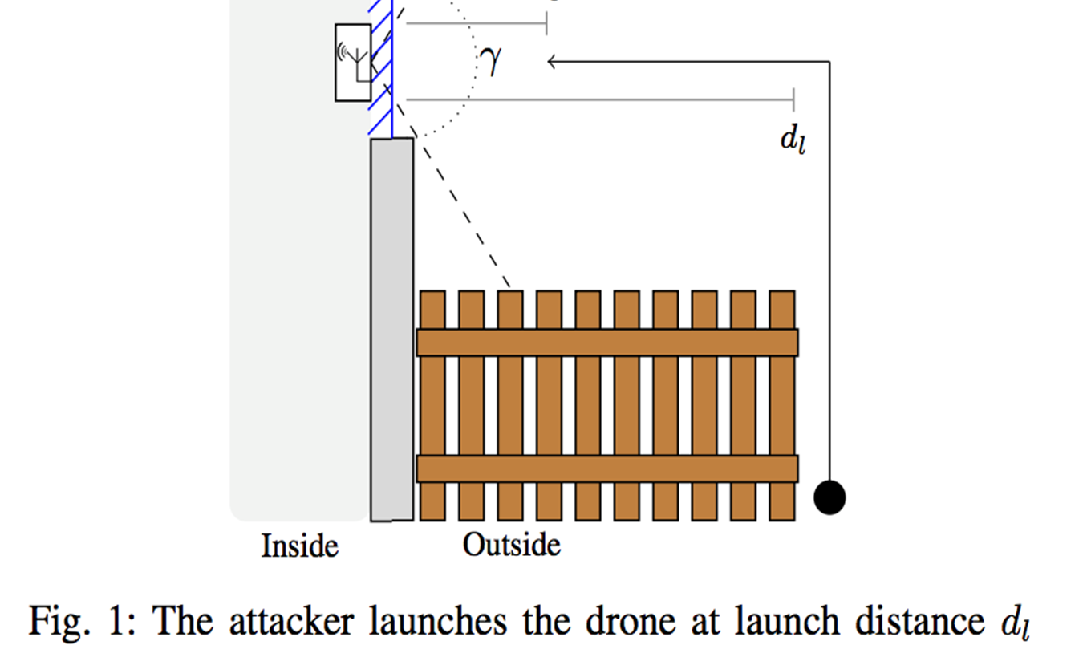
System Model:

Slide 9
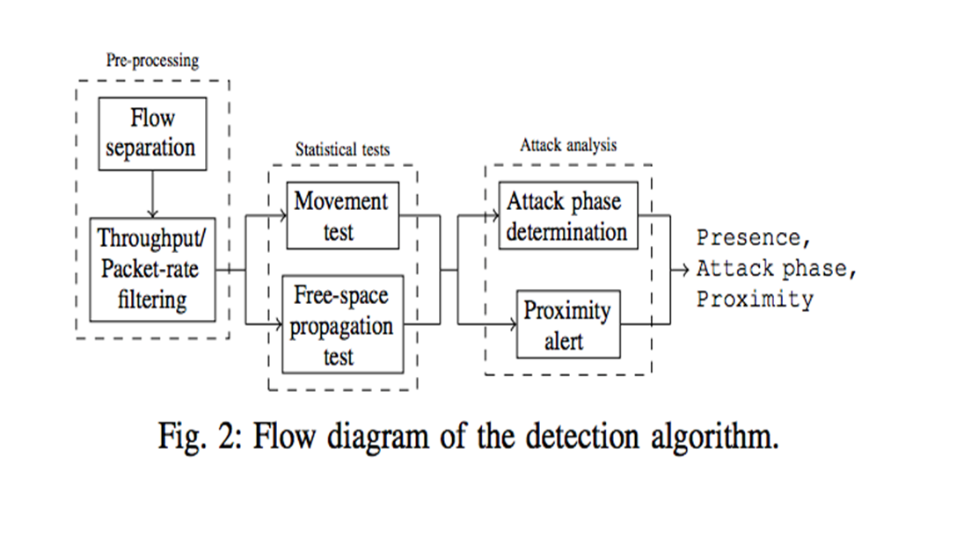
Detection Model:

Slide 10
Detection
3 stages of detection
Preprocessing phase prepares the stream of received packets for analysis
Statistical tests are applied to establish whether individual transmitters are moving and operating in free space.
Attack analysis phase determines if an attack is in progress and whether the drone has reached close proximity.

Slide 11
Detection: Pre-processing
This method assumes that the drone uses IEEE 802.11 Wi-Fi standard, flows are separated by MAC address.
This flow also has high bandwidth utilization
The detection process excludes flows that do not display this characteristic.

Slide 12
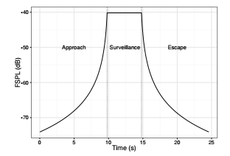
Detection(Cont.): Statistical tests
The system applies statistical tests to a flow to establish whether it is likely to represent a drone or not.
Simulation of the Free Space Path Loss during a privacy invasion attack with 5s surveillance. The speed of the drone is 5m/s, the surveillance distance ds is 1m.

Slide 13
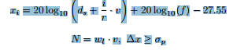
Detection Attack analysis
Just because the drone has stopped doesn’t mean that it is conducting surveillance
They created an algorithm that used the size of the window and the speed of the drone to determine if the drone is conducting surveillance
wl = be the window size
v = be the corresponding drone speed.
d =surveillance distance

Slide 14
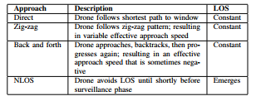
Detection Problems
This plan uses a direct approach other approaches could be more difficult to detect

Slide 15
Experimental Design:
Experiments conducted in England.
Two Raspberry Pi’s were installed in windows of the house.

Slide 16
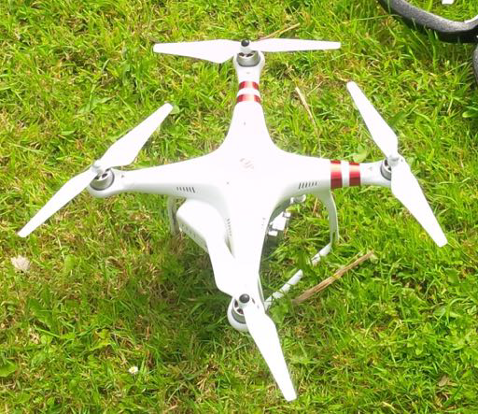
Experimental Design(Cont.)
Pi’s were connected via laptop using a Powerline network.
Two popular drones were used for testing.

Slide 17
Experimental Design(Cont.)
Attack runs were performed for each approach.
NLOS approach split into two categories.

Slide 18
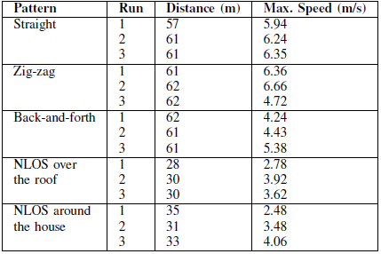
Experimental Design(Cont.)

Slide 19
Discussion/ Results:
The most notable discovery throughout our experiments was that detection happened earlier than our simulations had predicted.
Often the communication began before the drone took off
A problem is that if the drone flies close to the ground it is not detectable because of the ground reflections.

Slide 20
Future Work:
To understand the expected performance of the system in an urban environment to examine the effect of cross-traffic on detection.

Slide 21
Conclusion:
Developed a method to detect-privacy invasion attacks by drones based on their communication with a controller
Use of RSS (received signal strength)in the drone’s transmission
Monitored if the drone is approaching the detector or moving away from it, and to detect proximity to a receiver
Combined metrics to enables us to track the phase of the attack
Used two types of drones with various flight patterns and target windows
In summary, our system is able to detect drones flying nearby and can alert when a drone is in proximity of a window

